Slide 1
The Earnings-Return Relation

Slide 2
Agenda
Determinants of stock return
Asset pricing model
Intro to CRSP and event studies
Regression analysis (lab)

Slide 3
Background
  We have estimated valuation models and found that accounting information has become more value-relevant in recent years
  We still don’t know how accounting information is incorporated into stock price through price movements (i.e., stock return)

Slide 4
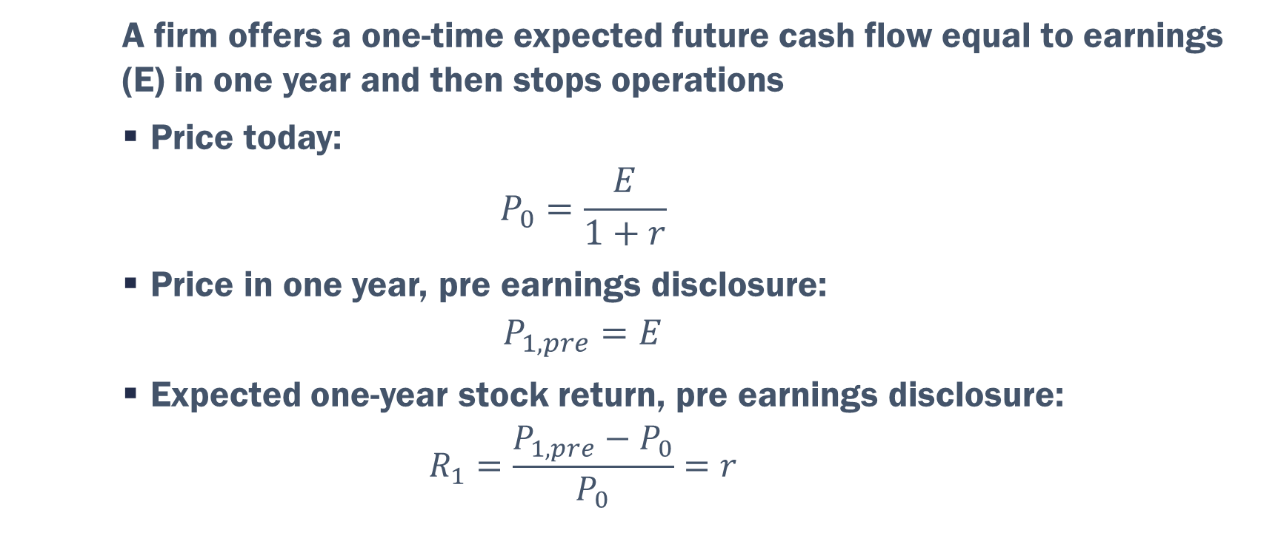
Buy-and-Hold Stock Return
  A firm offers a one-time expected future cash flow equal to earnings (E) in one year and then stops operations
  Price today:
  $$P_{0}=\frac{E}{1+r}$$
  Price in one year, pre earnings disclosure:
  $$P_{1,pre}=E$$
  Expected one-year stock return, pre earnings disclosure:
  $$R_{1}=\frac{P_{1,pre}−P_{0}}{P_{0}}=r$$

Slide 5
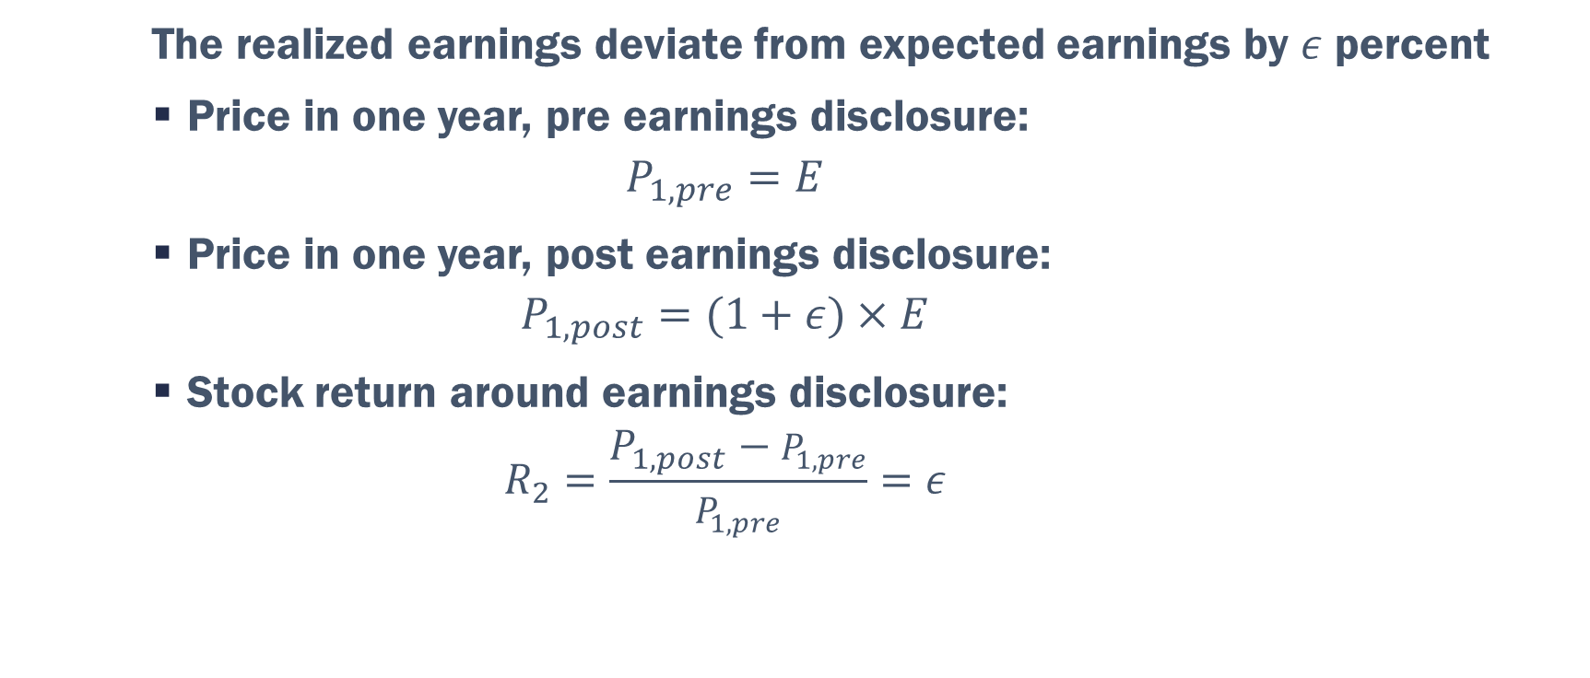
Earnings Announcement Return
  The realized earnings deviate from expected earnings by $ε$ percent
  Price in one year, pre earnings disclosure:
  $$P_{1,pre}=E$$
  Price in one year, post earnings disclosure:
  $$P_{1,post}=(1+ε)×E$$
  Stock return around earnings disclosure:
  $$R_{2}=\frac{P_{1,post}−P_{1,pre}}{P_{1,pre}}=ε$$

Slide 6
Two Drivers of Stock Returns
  New information
    Unexpected changes in fundamentals affect firm value
    Primarily short-term
  Risk
    Riskier assets must offer a higher expected return (a risk premium) to attract investors
    Primarily long-term

Slide 7
Asset Pricing Models
  Asset pricing models are financial economics frameworks that reflect the relation between risk and expected stock return, such as
  Capital Asset Pricing Model (CAPM)
  Fama-French Three-Factor Model

Slide 8
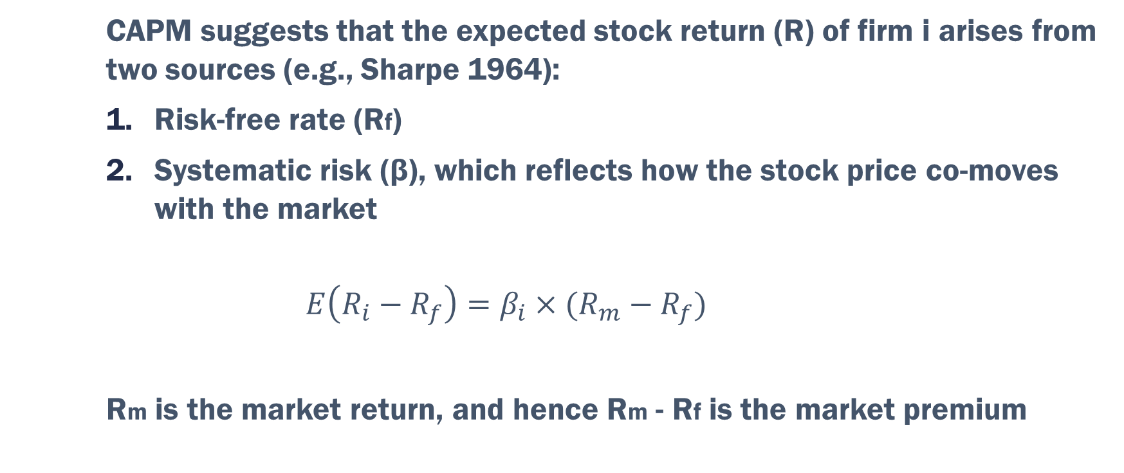
Capital Asset Pricing Model
  CAPM suggests that the expected stock return (R) of firm i arises from two sources (e.g., Sharpe 1964):
  Risk-free rate (Rf)
  Systematic risk (β), which reflects how the stock price co-moves with the market
  $$E\left(R_{i}−R_{f}\right)=β_{i}×(R_{m}−R_{f})$$
  Rm is the market return, and hence Rm - Rf is the market premium

Slide 9
Limitations of CAPM
  A single-factor model without incorporating fundamentals
  Difficult to implement
  Weak empirical support
  Unrealistic assumptions, such as a frictionless market, homogeneous expectations, etc.

Slide 10
Are there other risk factors?
  After CAPM, multiple empirical studies find that firm fundamentals are associated with stock returns
  Size, measured as market cap, is negatively associated with return
  Value, measured as the book-to-market ratio, is positively associated with return

Slide 11
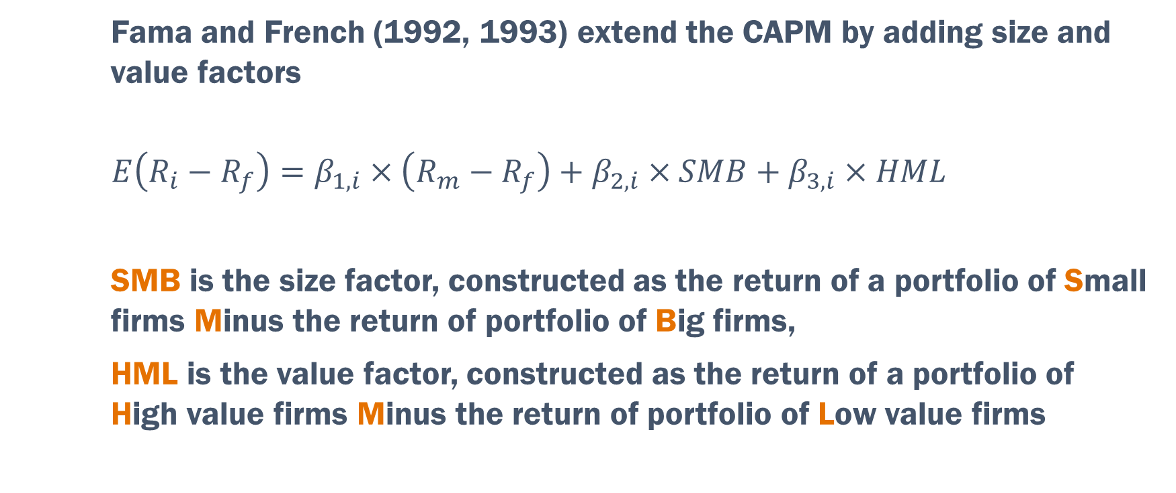
Fama-French Three-Factor Model
  Fama and French (1992, 1993) extend the CAPM by adding size and value factors
  $$E\left(R_{i}−R_{f}\right)=β_{1,i}×\left(R_{m}−R_{f}\right)+β_{2,i}×SMB+β_{3,i}×HML$$
  SMB is the size factor, constructed as the return of a portfolio of Small firms Minus the return of portfolio of Big firms,
  HML is the value factor, constructed as the return of a portfolio of High value firms Minus the return of portfolio of Low value firms

Slide 12
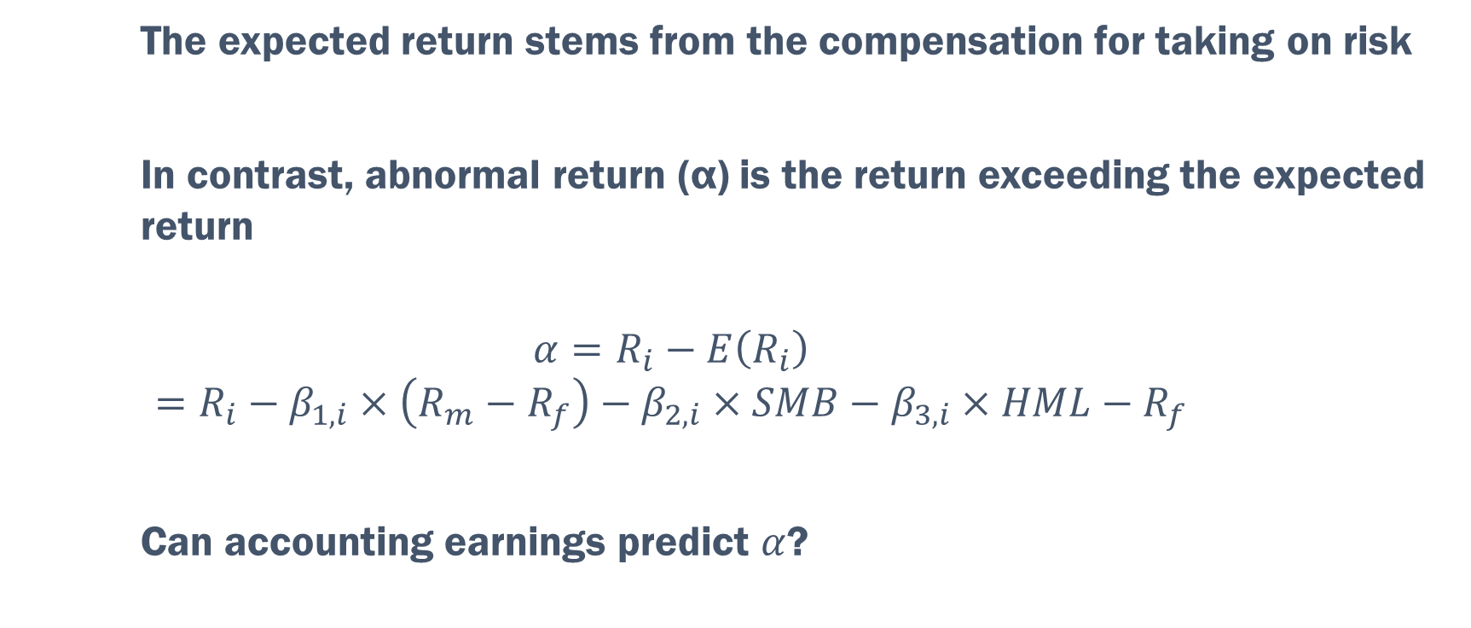
Abnormal Returns
  The expected return stems from the compensation for taking on risk
  In contrast, abnormal return (α) is the return exceeding the expected return
  $$α=R_{i}−E\left(R_{i}\right)=R_{i}−β_{1,i}×\left(R_{m}−R_{f}\right)−β_{2,i}×SMB−β_{3,i}×HML−R_{f}$$
  Can accounting earnings predict $α$?

Slide 13
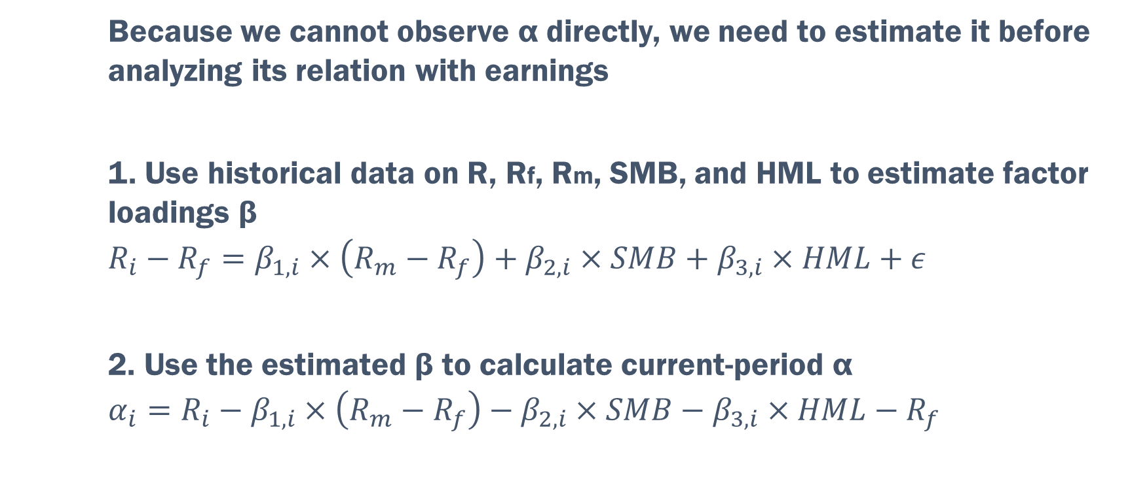
Estimate α
  Because we cannot observe α directly, we need to estimate it before analyzing its relation with earnings
  1. Use historical data on R, Rf, Rm, SMB, and HML to estimate factor loadings β
  $$R_{i}−R_{f}=β_{1,i}×\left(R_{m}−R_{f}\right)+β_{2,i}×SMB+β_{3,i}×HML+ε$$
  2. Use the estimated β to calculate current-period α
  $$α_{i}=R_{i}−β_{1,i}×\left(R_{m}−R_{f}\right)−β_{2,i}×SMB−β_{3,i}×HML−R_{f}$$

Slide 14
CRSP Database
  The Center for Research in Security Prices (CRSP) developed the first market database that tracks stock returns
  Founded at the University of Chicago, CRSP is widely used, not only by academics but also by practitioners

Slide 15
CRSP in WRDS
On the home page, find “CRSP”
We will use
“CRSP/Compustat Merged” for financial statements data
“Event Study by WRDS” for stock return data
  This is a separate WRDS module; not under CRSP but enabled by CRSP data

Slide 16
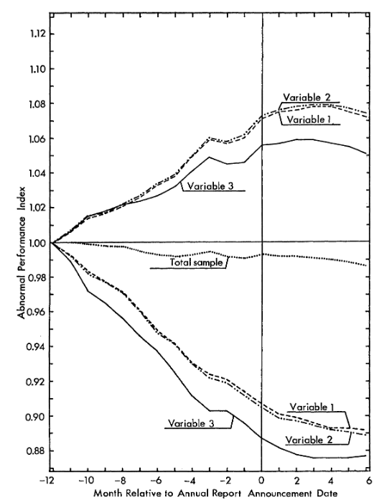
Ball and Brown (1968)
Notes:
Source: An Empirical Evaluation of Accounting Income Numbers
Ray Ball, Philip Brown
Journal of Accounting Research, Vol. 6, No. 2 (Autumn, 1968), pp. 159-178 (20 pages)

Slide 17
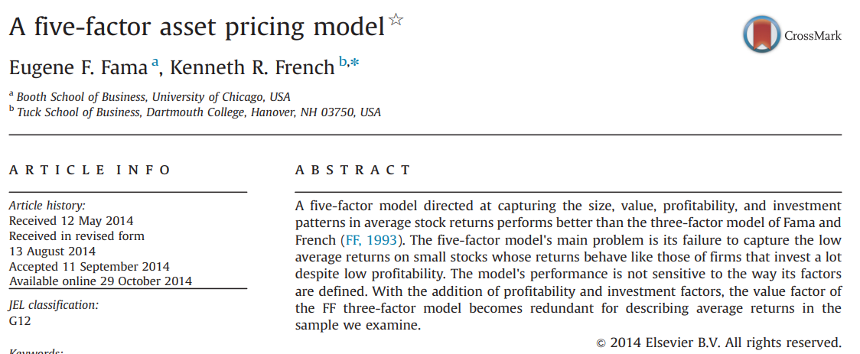
Fama and French (2015)

